Slide 1
Gate Level Minimization
Chapter 3
Imran Siddiqi
imran.siddiqi@mcs.edu.pk
Computer Science Department
College of Telecommunication Engineering
National University of Sciences and Technology

Slide 2
Gate Level Minimization
Although truth tables representation of a function is unique, it can be expressed algebraically in different forms
The procedure of simplifying Boolean expressions is difficult since it lacks specific rules to predict the successive steps in the simplification process.
Alternative
Karnaugh Map (K-map) Method

Slide 3






K-Map
A K-Map is a graphical representation of a logic function’s truth table
y
y
x
m₀
m₁
m₂
m₃
x

Slide 4
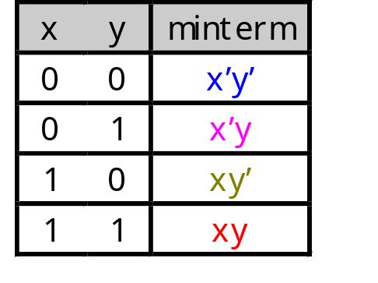
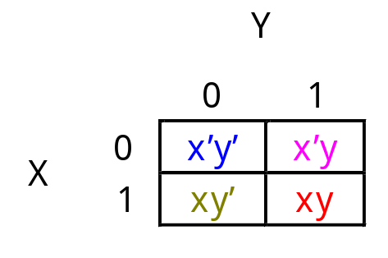
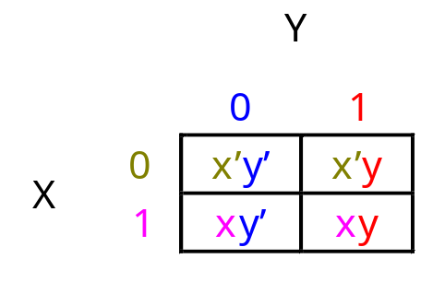
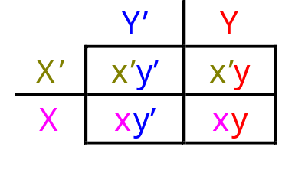
Re-arranging the Truth Table
A two-variable function has four possible minterms. We can re-arrange these minterms into a Karnaugh map
Now we can easily see which minterms contain common literals
  Minterms on the left and right sides contain y’ and y respectively
  Minterms in the top and bottom rows contain x’ and x respectively

Slide 5
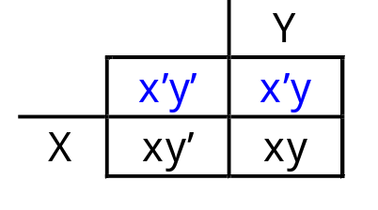
K-Map Simplification
Imagine a two-variable sum of minterms:
Both of these minterms appear in the top row of a Karnaugh map, which means that they both contain the literal x’
What happens if you simplify this expression using Boolean algebra?
x’y’ + x’y
x’y’ + x’y = x’(y’ + y) [ Distributive ]
= x’ • 1 [ y + y’ = 1 ]
= x’ [ x • 1 = x ]

Slide 6
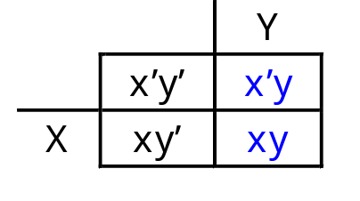
K-Map:Two-Variable Examples
Another example expression is x’y + xy
  Both minterms appear in the right side, where y is uncomplemented
  Thus, we can reduce x’y + xy to just y

Slide 7
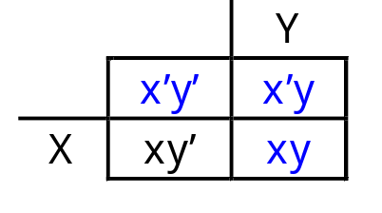
K-Map:Two-Variable Examples
How about x’y’ + x’y + xy?
  We have x’y’ + x’y in the top row, corresponding to x’
  There’s also x’y + xy in the right side, corresponding to y
  This whole expression can be reduced to x’ + y

Slide 8
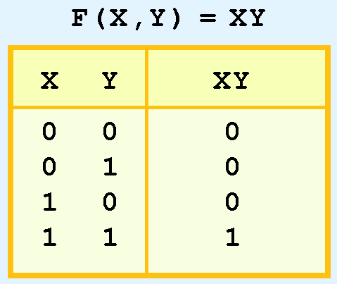
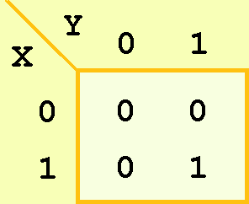
K-Map:Two-Variable Examples
The truth table for the function F(x,y) = xy is shown at the right along with its corresponding Kmap.

Slide 9
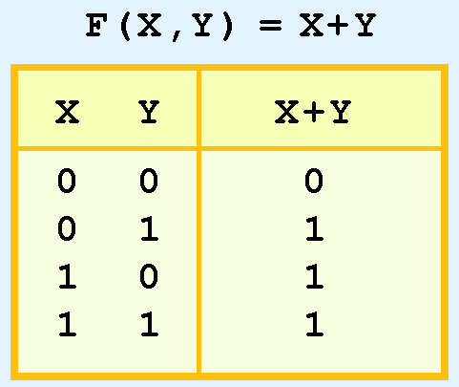
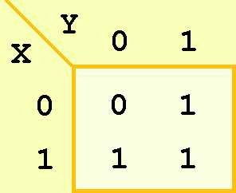

K-Map:Two-Variable Examples
As another example, we give the truth table and KMap for the function, F(x,y) = x + y at the right.
This function is equivalent to the OR of all of the minterms that have a value of 1. Thus:

Slide 10
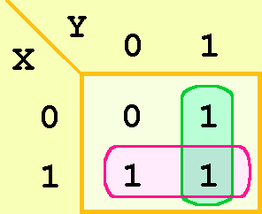
K-Map Simplification
We can reduce complicated expression to its simplest terms by finding adjacent 1s in the Kmap that can be collected into groups that are powers of two.
In our example, we have two such groups:

Slide 11
K-Map Simplification: Rules
Groupings can contain only 1s; no 0s.
Groups can be formed only at right angles; diagonal groups are not allowed.
The number of 1s in a group must be a power of 2 – even if it contains a single 1.
The groups must be made as large as possible.
Groups can overlap and wrap around the sides of the Kmap.

Slide 12
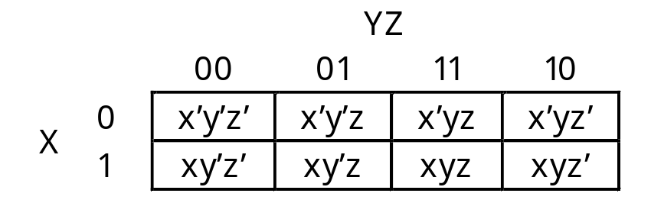
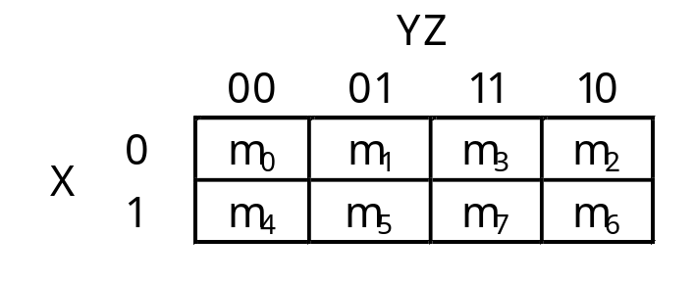
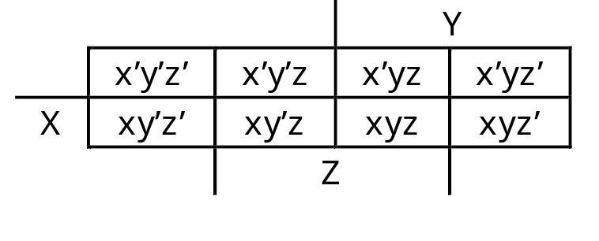
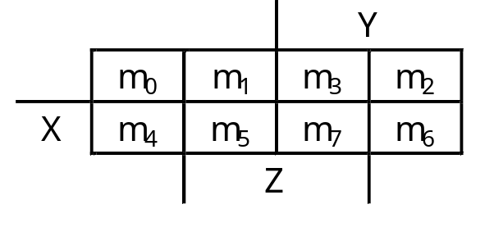
Three Variable K-Map
For a three-variable expression with inputs x, y, z, the arrangement of minterms is more tricky:
Another way to label the K-map (use whichever you like):

Slide 13
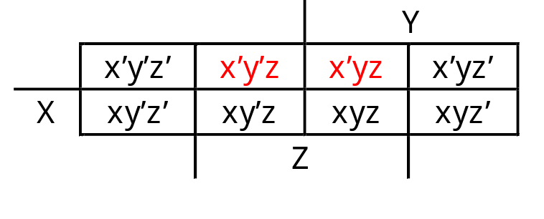
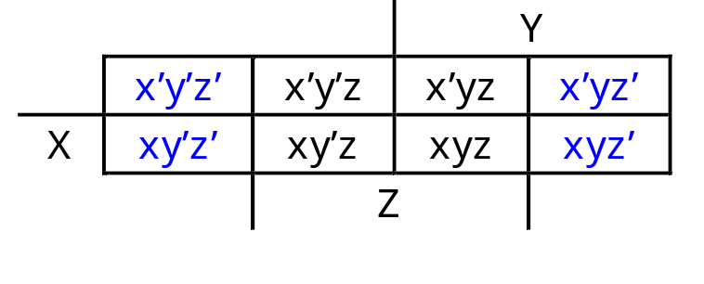
Why this Ordering?
With this ordering, any group of 2, 4 or 8 adjacent squares on the map
contains common literals that can be factored out
“Adjacency” includes wrapping around the left and right sides:
We’ll use this property of adjacent squares to do our simplifications.
x’y’z + x’yz
= x’z(y’ + y)
= x’z • 1
= x’z
  x’y’z’ + xy’z’ + x’yz’ + xyz’
  = z’(x’y’ + xy’ + x’y + xy)
  = z’(y’(x’ + x) + y(x’ + x))
  = z’(y’+y)
  = z’

Slide 14
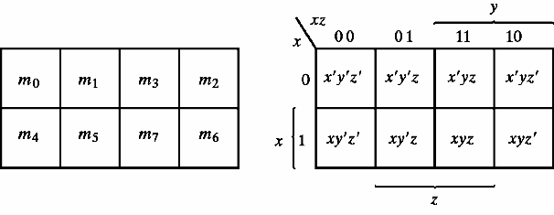
Examples: Three Variable Kmap
yz
x

Slide 15
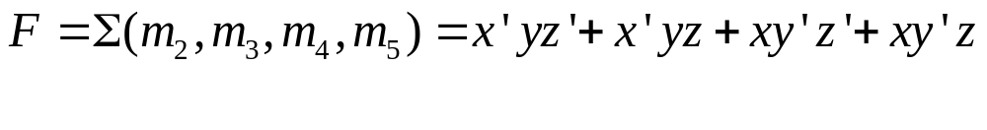
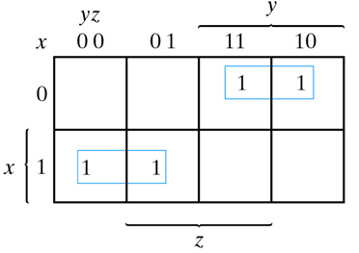
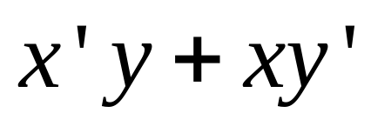
Examples: Three Variable Kmap

Slide 16
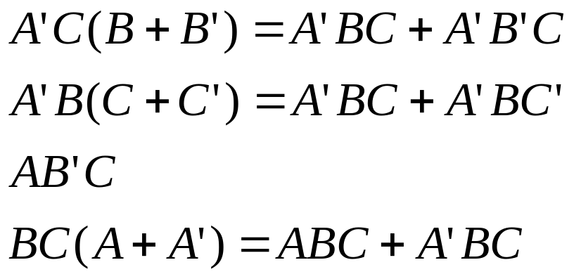
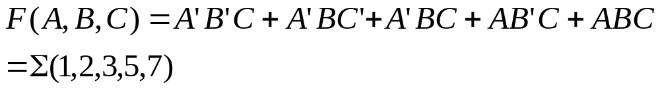
Examples: Three Variable Kmap
Given:
(a) Express F in sum of minterms.
(b) Find the minimal sum of products using K-Map

Slide 17

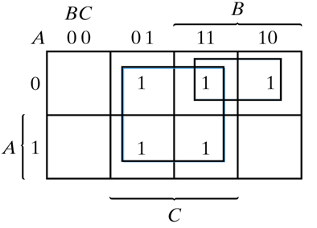

Examples: Three Variable Kmap
m₀ | m₁ | m₃ | m₂
m₄ | m₅ | m₇ | m₆

Slide 18
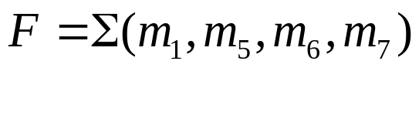
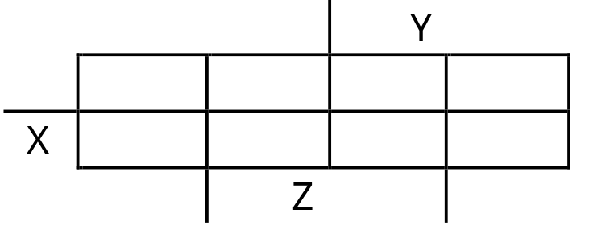
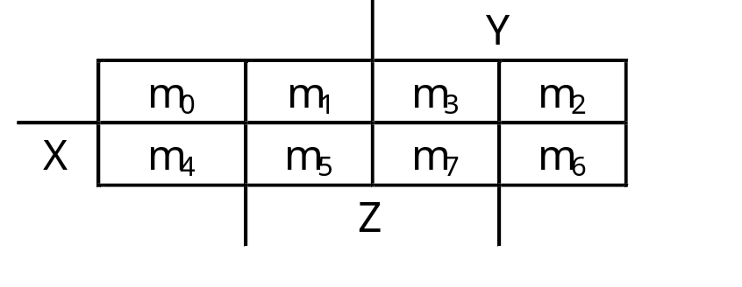
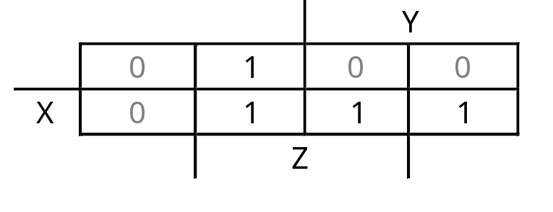
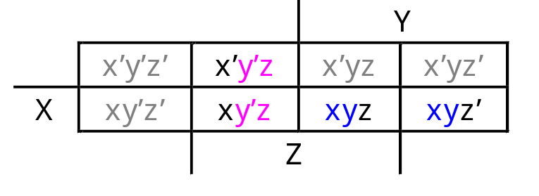
Examples: Three Variable Kmap
y’z
xy
F(x,y,z)= y’z + xy

Slide 19
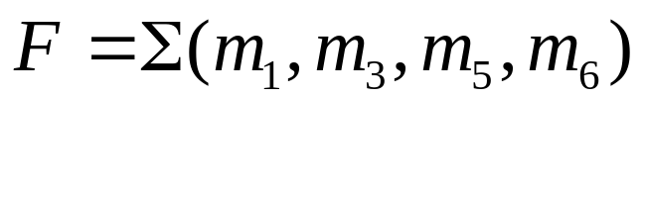
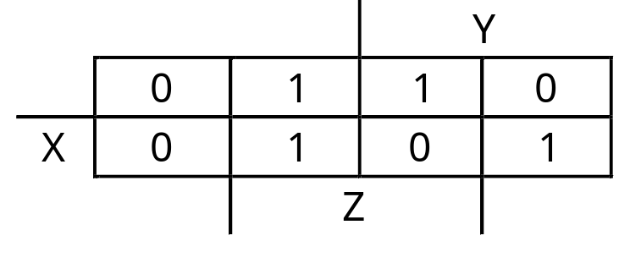
Examples: Three Variable Kmap
x’z + y’z + xyz’

Slide 20
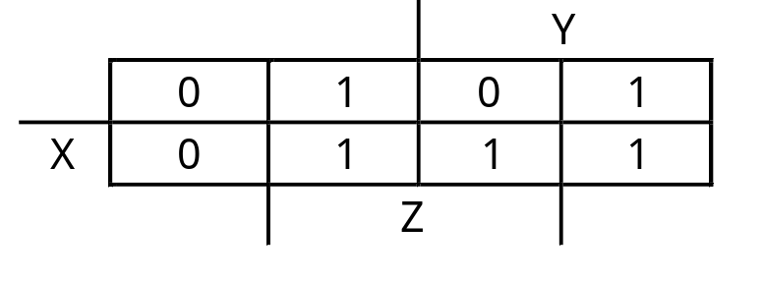
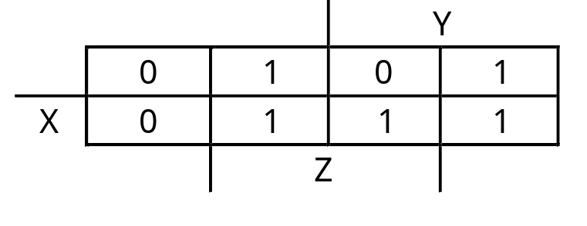

Kmaps can be tricky
y’z + yz’ + xy
y’z + yz’ + xz

Slide 21
Three Variable Kmaps
One square represents one minterm → a term of 3 literals
Two adjacent squares → a term of 2 literals
Four adjacent squares → a term of 1 literal
Eight adjacent squares → the function equals to 1

Slide 22
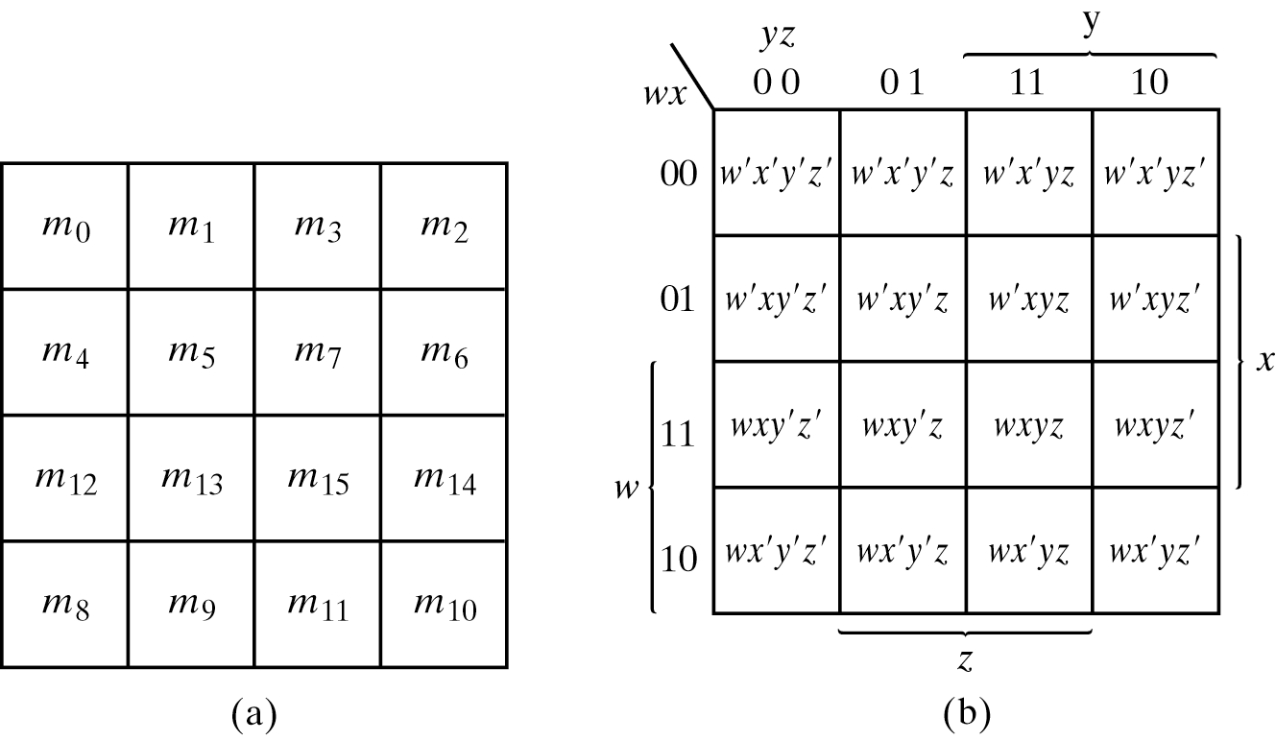
Four Variable Kmap

Slide 23
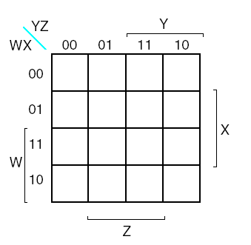
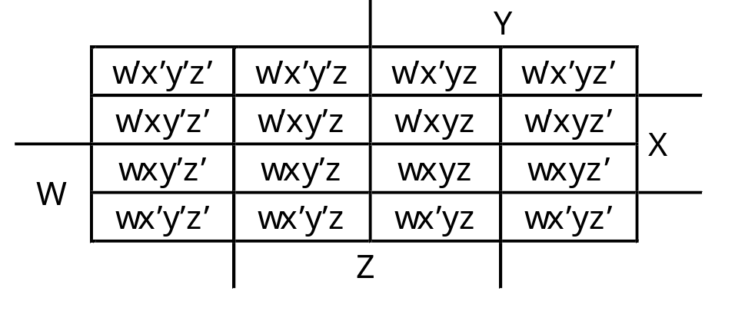
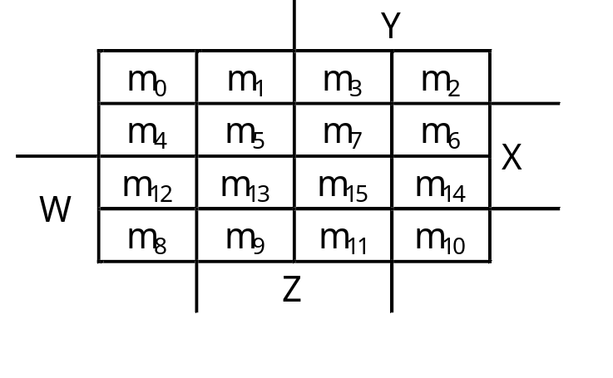
Four Variable Kmap

Slide 24
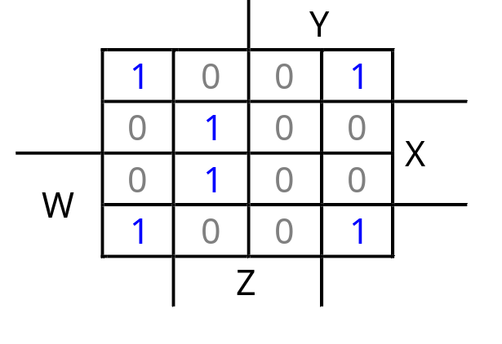
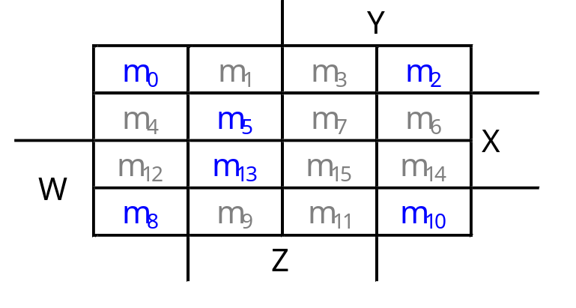
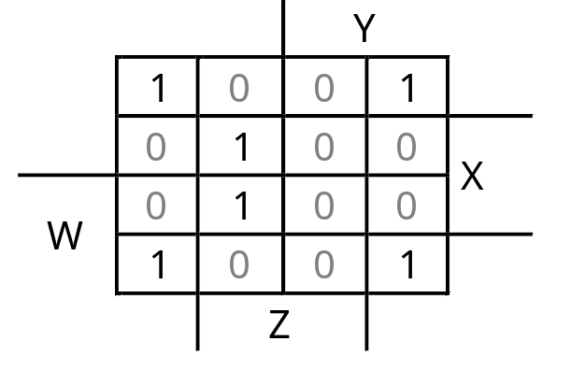
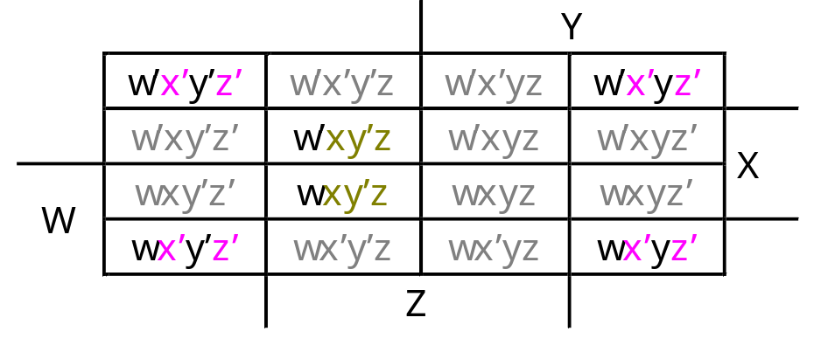
Example: 4 Variable Kmap
Simplify m0+m2+m5+m8+m10+m13

Slide 25
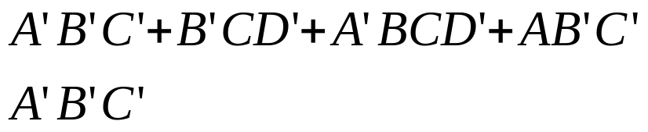
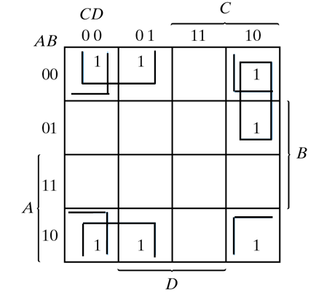
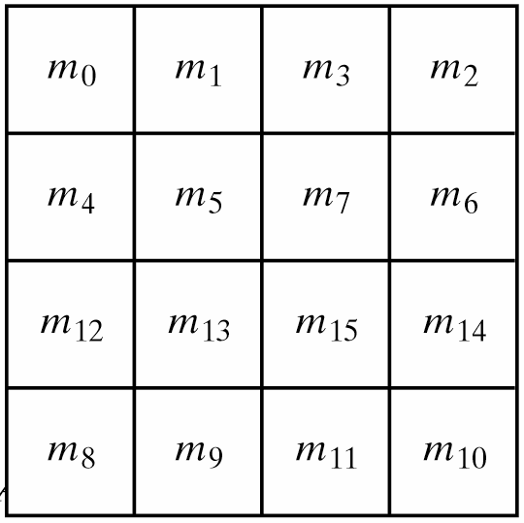

Example: 4 Variable Kmap
Simplify F(A,B,C,D) =
Represented by 0001 or 0000

Slide 26
Four Variable Kmap
One square represents one minterm → a term of 4 literals
Two adjacent squares → a term of 3 literals
Four adjacent squares → a term of 2 literal
Eight adjacent squares → a term of 1 literal
Sixteen adjacent squares → the function equals to 1

Slide 27
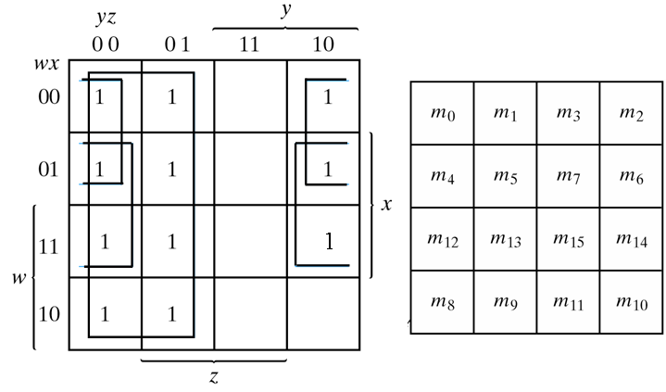
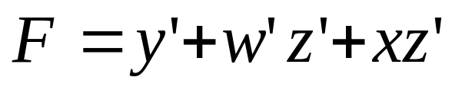
Example: 4 Variable Kmap
Simplify F(w,x,y,z) = Σ(0,1,2,4,5,6,8,9,12,13,14)

Slide 28
References
Chapter 3 – Digital Design Morris Mano
Material in these slides has been taken from, the following resources

